Slide 1

SAS project
EXAM OF STATISTICAL SOFTWARE
UNIVERSITY OF BOLOGNA
SUSANNA CASARINI

Slide 2
ADDRESSES dataset:
424 observations, 9 variables.
Informations about employee addresses.
ORGANIZATIONS dataset:
424 observations, 4 variables.
Informations about job role and department in the organization.
DONATIONS dataset:
124 observations, 7 variables.
Informations about employee donations, divided in four periods.
DATA:

Slide 3
AIMs:
Create a rtf report with employees informations.
Create a second report with employee informations about donations, dividing employees by department and job role.
Create a table and a report with informations about donations in a specific period, dividing employees by department.
Create a second table with the same informations, dividing employees by job role.
Create a new variable to classify employees as “benefactors” if the total number of donations is greater than 1 and the total amount exceeds 30$.
Study the association between job role and being a benefactor.

Slide 4
First report: Employee informations.
Records of clients that made at least one donation.
DATA STEP to create three datasets in the work library
PROC CONTENTS to understand the datasets
PROC SORT to sort the data by Employee_ID
MERGE statement in the data step, to create a new dataset using a one by many procedure, selecting only the ones who made donations.
CATX statement to create the new variable addresses
PROC REPORT step to create a rtf file

Slide 5
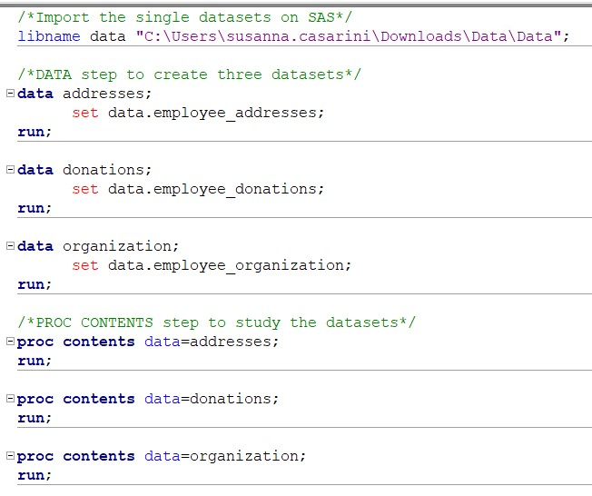
First report:
Employee informations.
LIBNAME
and PROC CONTENTS

Slide 6
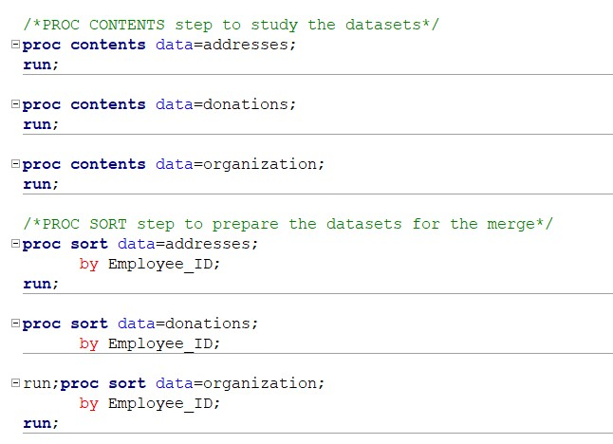
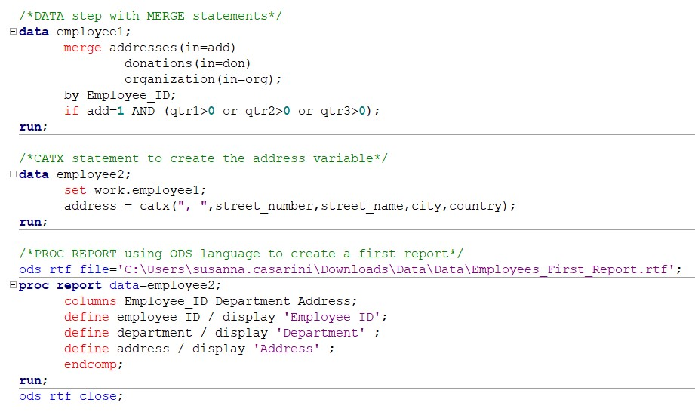
First report: Employee informations.
PROC SORT, MERGE and CATX statements

Slide 7
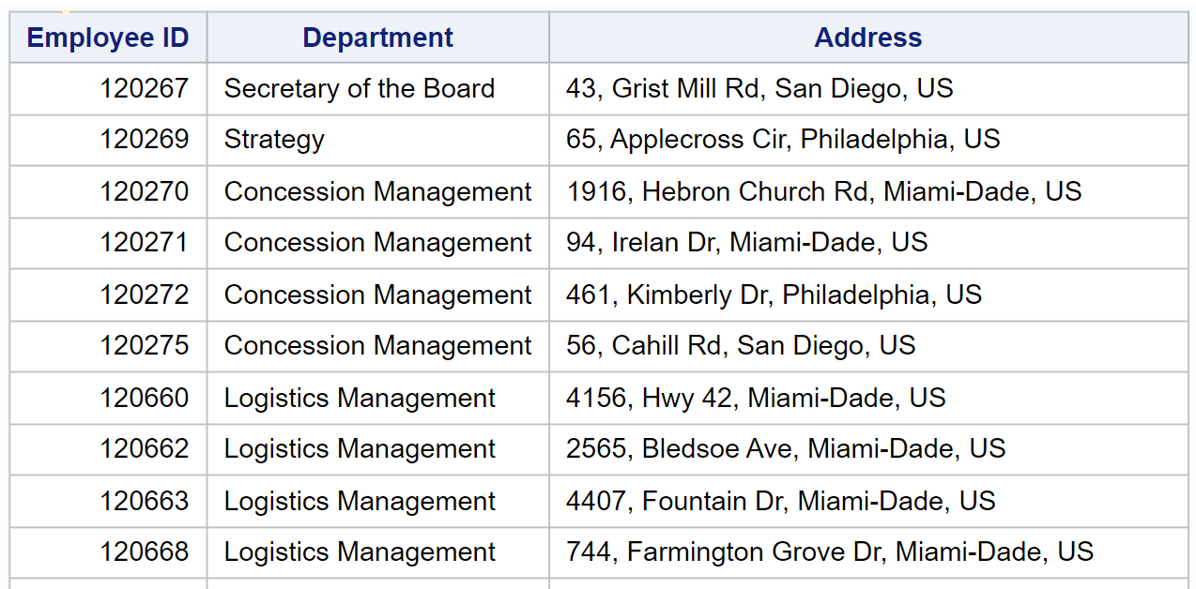
First report: Employee informations.
rtf report

Slide 8
Second report: Employee donations.
Employee donations by department and job role.
DATA STEP to calculate the mean, the minimum and the maximum of the donations in different periods
PROC REPORT step to create a rtf file with the statistics of donations for every period, divided by department and job role.

Slide 9
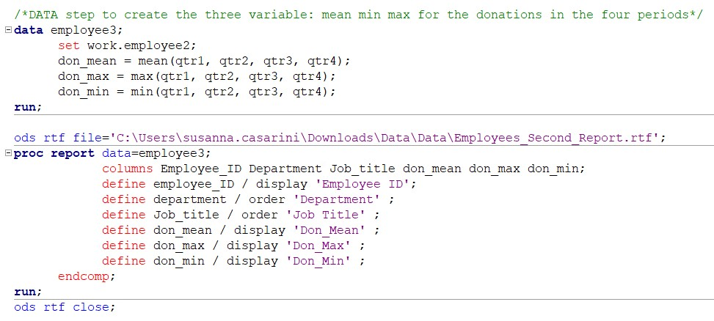
Second report: Employee donations.
DATA step and PROC REPORT

Slide 10
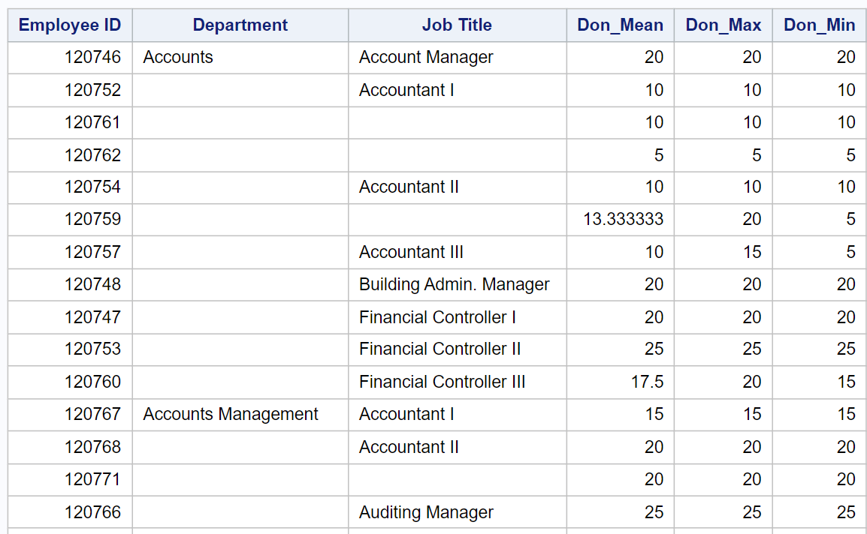
Second report: Employee donations.
rtf report of employee donations by department and job role.

Slide 11
First table: means of employee donations.
means of donations by department for every period.
PROC MEANS and CLASS statement to calculate the donations mean for every period by department
PROC SORT to sort data by department
PROC TRANSPOSE to transpose the donations variables and create the period variable
PROC REPORT to display the table

Slide 12
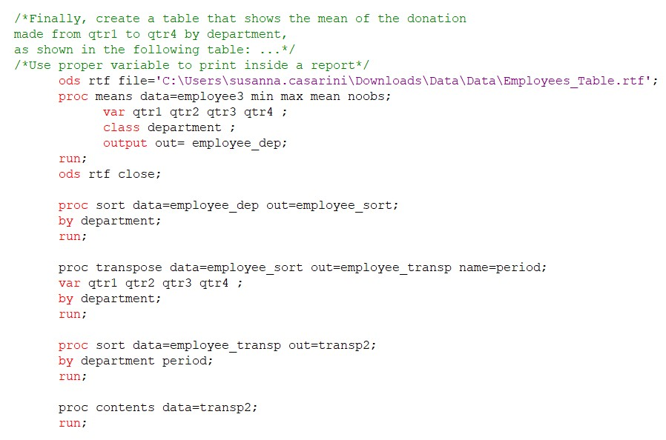
First table: means of employee donations.
PROC MEANS and PROC TRANSPOSE

Slide 13
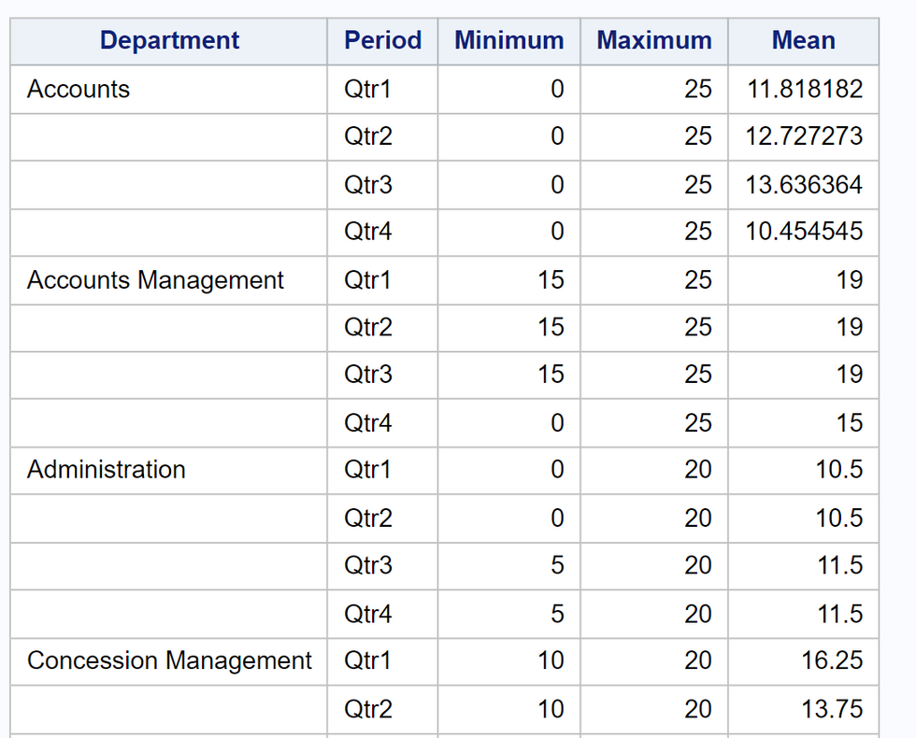
First table: means of employee donations.
Table report

Slide 14
Second table: means of employee donations.
means of donations by job role for every period
MACRO to use the code of the previous table, setting the grouping variable as option.
Apply the MACRO to the job role variable

Slide 15
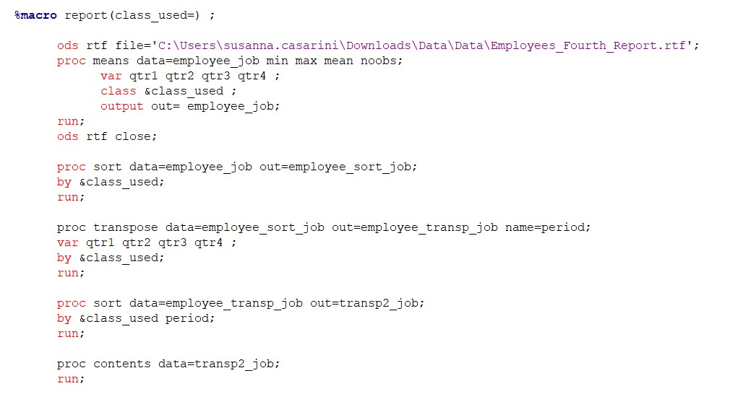
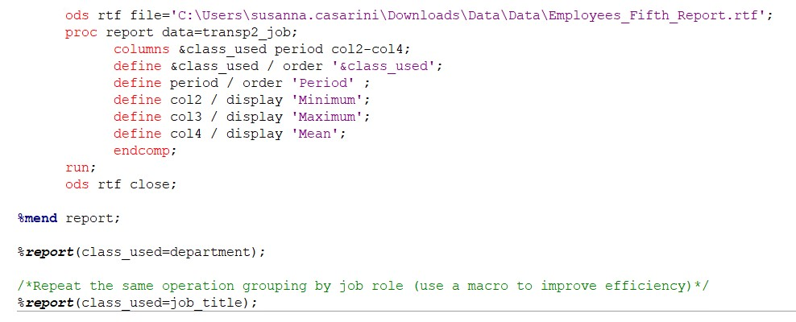
Second table: means of employee donations.
means of donations by job role for every period

Slide 16
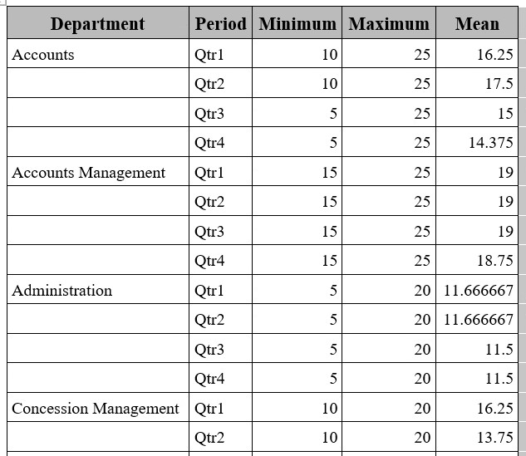
Second table: means of employee donations.
means of donations by job role for every period

Slide 17
Frequency table: benefactor and job role.
Association between being a benefactor and job.
DATA STEP to create a flag variable BNFL. Classification of “Benefactors” as employees who made at least one donation and total amount exceeds 30$.
PROC FREQ to study the association between the two variables

Slide 18
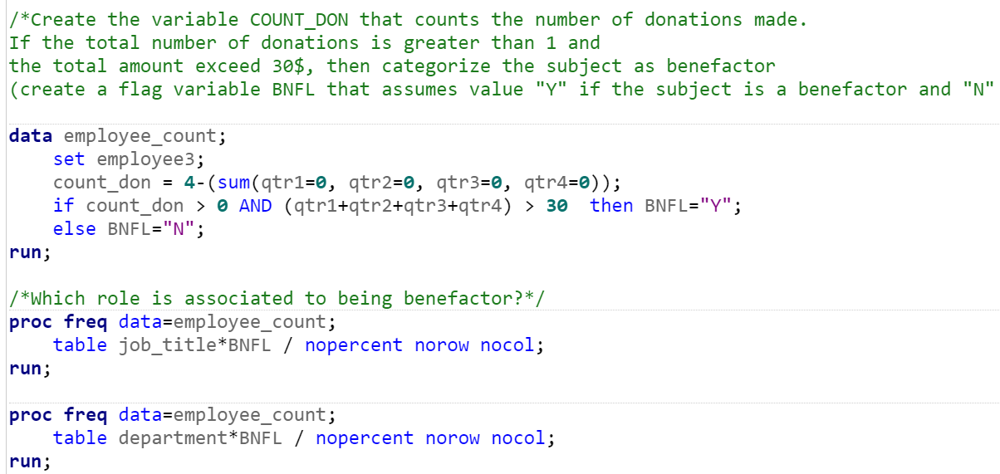
Frequency table: benefactor and job role.
PROC FREQ

Slide 19
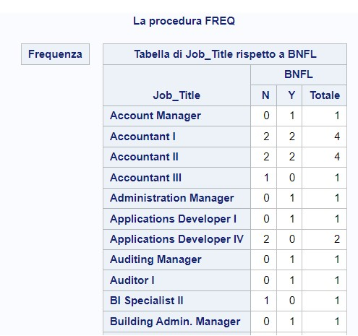
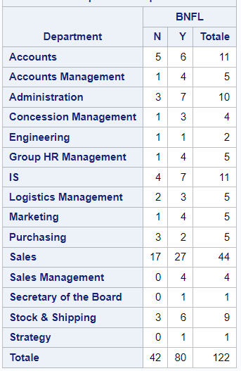
Frequency table: benefactor and job role.
Association between being a benefactor and job.

Slide 20
Thank you
for the attention!

